Slide 1

FLYWHEEL AND CRANK MECHANISM
Manufacturing Process – Project Based Learning

Slide 2
TEAM GRAVITECH
Prof. Shruthi M N
Assistant Professor,
Industrial Engineering Dept.
Dr. Rajeswara Rao K V S
Head of Department,
Industrial Engineering Dept.
Team Members :-
1. Aryan Lodha - 1RV24IM064
2. Yashveer Singh - 1RV24IM061
3. Vivek Bainsla - 1RV24IM059

Slide 3
EL Phase-II
Presentation Outline
Introduction
Literature Review
Problem Definition
Objectives
Methodology
Proposed Outcomes
Timeline of the project
Conclusion
References

Slide 4
Introduction
Overview
Flywheel and crank mechanism is a fundamental mechanical system.
It converts rotary motion into reciprocating motion and vice versa.
Commonly used in engines, pumps, compressors, and machine tools.
Ensures smooth and continuous power transmission.
Plays a key role in speed regulation and energy storage

Slide 5
Problem Definition
Direct conversion of motion causes uneven speed and vibration.
Lack of energy storage leads to fluctuating output.
Mechanical systems require smooth and continuous motion transfer.
A reliable mechanism is needed to reduce speed variation and shocks.

Slide 6
Literature Review
Relevance to current research:
Supports the continued use of mechanical mechanisms for reliable motion conversion in engineering systems.
Validates the effectiveness of the flywheel–crank mechanism in reducing speed fluctuations and vibration.
Aligns with industrial requirements for smooth, continuous, and energy-efficient motion transmission.
Our project contributes by designing and fabricating a laboratory-scale flywheel and crank mechanism to demonstrate practical manufacturing and kinematic concepts.

Slide 7
Literature Review
Theoretical Framework:
Principle: Conversion between rotary motion and reciprocating motion with energy regulation using a flywheel.
→ Mechanism:
  Flywheel stores rotational energy during power stroke.
  Stored energy is released during non-power stroke to maintain uniform speed.
Relevance: Forms the core working principle of the fabricated flywheel and crank mechanism model.

Slide 8
Objectives
To design and fabricate a flywheel and crank mechanism.
To understand the working principle of the mechanism.
To study conversion between rotary and reciprocating motion.
To gain hands-on experience with manufacturing processes.
To improve understanding of alignment, balance, and inertia effects.

Slide 9
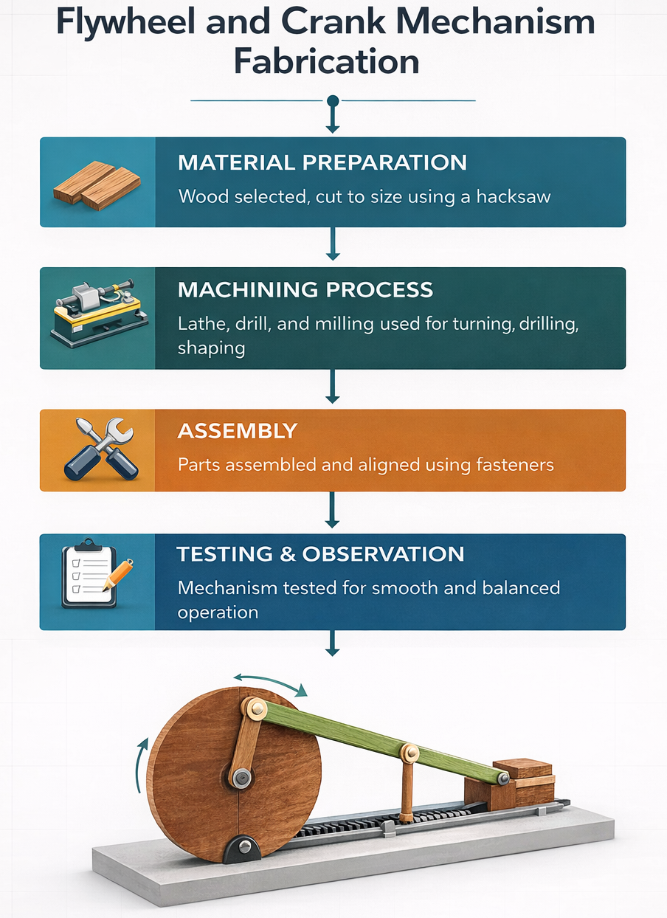
Methodology
Flowchart: Flow of Work

Slide 10
Working Principle
Crank rotates about a fixed axis.
Connecting rod transfers motion to the slider.
Slider moves linearly in a guideway.
Flywheel stores excess energy during power stroke.
Stored energy is released during non-power stroke for smooth motion.

Slide 11
Main Components
Flywheel
Crankshaft
Connecting rod
Slider
Base and guideways
Fasteners and joints

Slide 12
Material Selection
Wood selected as primary material.
Easy to machine and shape.
Suitable for demonstrating working principle clearly.
Provides sufficient strength for laboratory-scale model.
Cost-effective and safe for student fabrication.

Slide 13
Machines Used
Power hacksaw / Band saw
Lathe machine
Drilling machine
Milling machine
Grinding machine
Bench grinder

Slide 14
Measuring and Assembly Tools
Vernier caliper
Micrometer
Steel rule
Dial gauge
Spanners, Allen keys, screwdrivers
Lubricating oil and grease

Slide 15
Operations Performed
Cutting
Facing
Turning
Drilling
Milling
Grinding and finishing
Assembly and testing

Slide 16
Manufacturing Details
Flywheel
Radius: 100 mm
Thickness: 18 mm
Operations:
Cutting
Facing
Turning
Drilling
Connecting Rod
Length: 330 mm
Thickness: 20 mm
Operations:
Cutting
Facing
Turning
Drilling
Milling
Grinding
Slider
- Length: 330 mm
Operations:
Cutting
Facing
Turning
Drilling
Slider Block
Height: 40 mm
Length: 48 mm
Breadth: 36 mm
Operations:
Cutting
Facing
Milling
Grinding

Slide 17
Outcomes
Successfully designed and fabricated a working flywheel and crank mechanism model.
Achieved smooth conversion between rotary and reciprocating motion.
Observed effective reduction in speed fluctuation due to flywheel action.
Gained practical exposure to lathe, milling, drilling, and grinding operations.
Improved understanding of mechanism kinematics, balance, and alignment.
Developed skills in precision manufacturing, assembly, and teamwork.
Enhanced confidence in handling real-world manufacturing challenges.

Slide 18
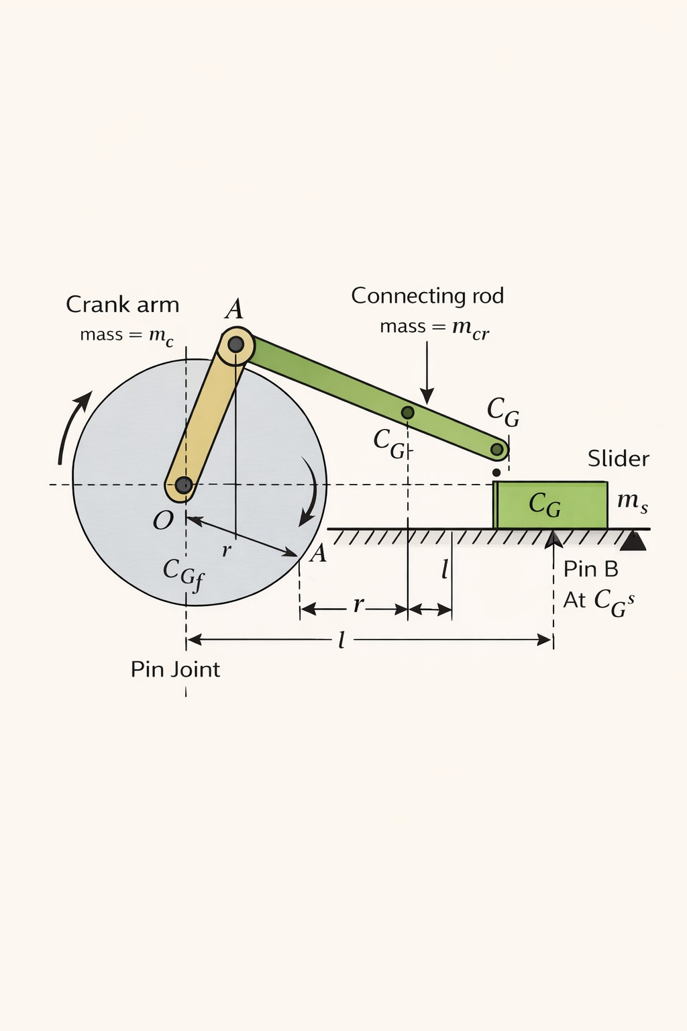
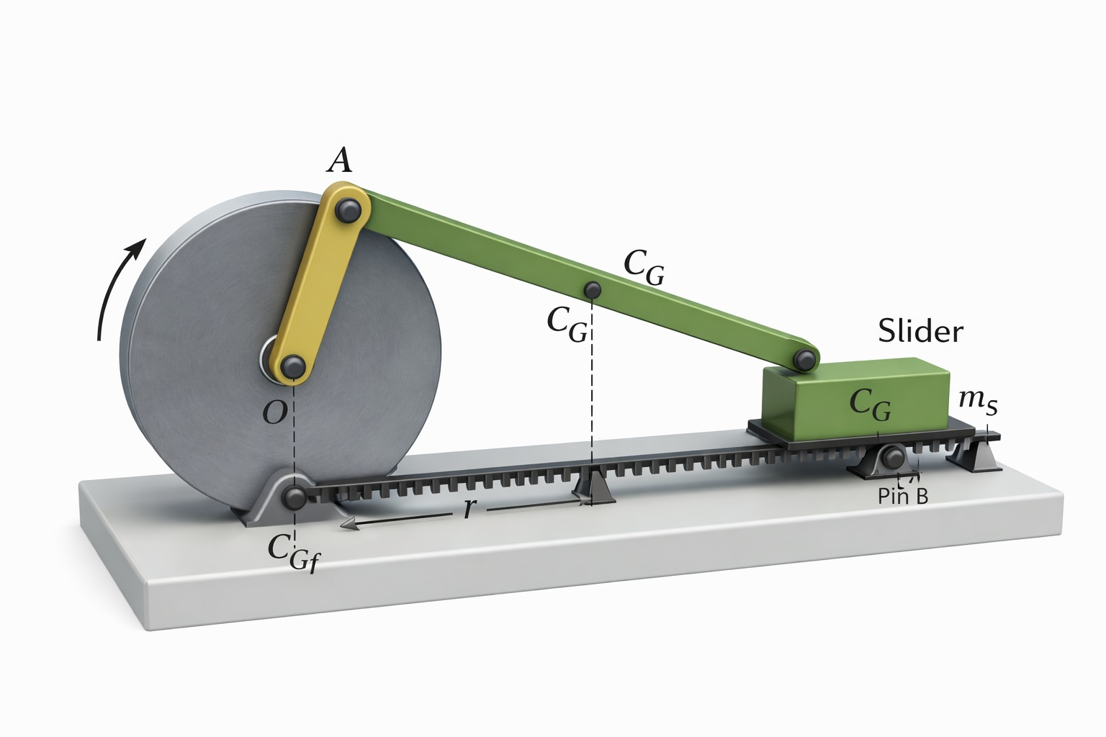
2D and 3D Images

Slide 19
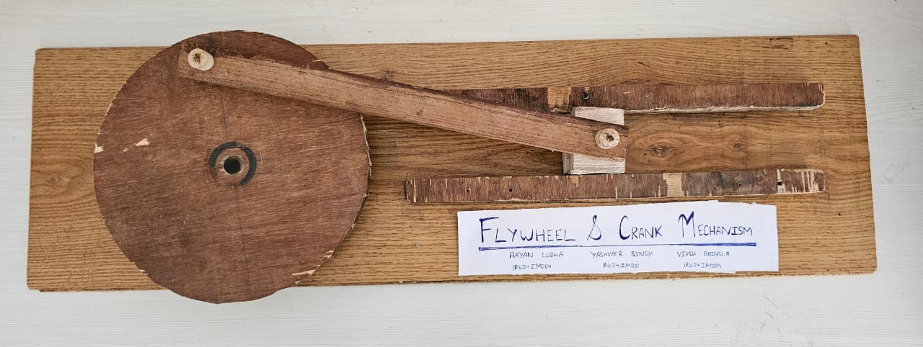
Visuals

Slide 20
Conclusion
The flywheel and crank mechanism was successfully fabricated and tested under laboratory conditions.
The project demonstrated the practical application of theoretical concepts learned in manufacturing processes.
Flywheel action ensured smooth and continuous motion, validating its role in energy storage and speed regulation.
Accurate machining and proper assembly proved critical for efficient and vibration-free operation.
The project strengthened understanding of mechanical design, machining accuracy, and motion transmission.
Overall, this PBL activity effectively bridged the gap between theory and hands-on engineering practice.

Slide 21
References
List of References:
Mechanism Theory & Kinematics
Raghuwanshi, N. Theory of Machines. Laxmi Publications.
Shigley, J. E., & Uicker, J. J. Theory of Machines and Mechanisms. McGraw-Hill.
Norton, R. L. Design of Machinery. McGraw-Hill Education.
Flywheel & Energy Storage Studies
Bhandari, V. B. Design of Machine Elements. Tata McGraw-Hill.
Khurmi, R. S., & Gupta, J. K. A Textbook of Machine Design. S. Chand Publications.
Spotts, M. F. Design of Machine Elements. Prentice Hall.
Manufacturing Processes
Kalpakjian, S., & Schmid, S. Manufacturing Engineering and Technology. Pearson Education.
Rao, P. N. Manufacturing Technology: Metal Cutting and Machine Tools. McGraw-Hill.
Groover, M. P. Fundamentals of Modern Manufacturing. Wiley.
Laboratory & Academic Resources
Manufacturing Process Laboratory Manual, RV College of Engineering.
Lecture notes and course material provided by the department.

Slide 22


